Slide 1
BATTERY MANAGEMENT SYSTEM
PIP2001 Capstone Project
Final Review
Batch Number: 04
ROLL NUMBER | NAME
20211CIT0176 | PRUTHVI R PATEL
20211CIT0063 | MONISH KUMAR V
20211CIT0018 | T JASHWANTH
20211CIT0071 | REDDY MANOJ
20211CIT0165 | M SANDEEP
Under the Supervision of,
DR.SHARMASTH VALI Y
Associate Professor
School of Computer Science and Engineering
Presidency University
Name of the Program:
Name of the HoD: Dr. Anandaraj S P
Name of the Program Project Coordinator: Dr. Sharmasth Vali Y
Name of the School Project Coordinators: Dr. Sampath A K / Dr. Abdul Khadar A / Mr. Md Ziaur Rahman
Name of the Project Reviewer:Mr.Sakthivel E

Slide 2
Introduction
In today’s digital world, smartphones have become indispensable tools, serving a wide range of functions from communication and entertainment to productivity and health tracking. As mobile devices become more powerful, their energy demands increase, often causing batteries to overheat, especially during intensive tasks like gaming, video streaming, or fast charging. Overheating not only degrades battery life but can also lead to severe issues such as reduced performance, hardware failure, or even dangerous battery explosions.

Slide 3
Literature Review
Sl.no. | Paper Title | Proposed Model | Results | Drawbacks
1. | [1] DASARI HETHU AVINASH 1 AND A. RAMMOHAN 2 “Integrating Level Shift Anomaly Detection for Fault Diagnosis of Battery Management System for Lithium-Ion Batteries”. 10.1109/ACCESS.2024.3445955 | LevelshiftAD for anomaly detection in LIBs. Analyzes temperature data from battery packs. Detects faults during internal short circuits. | LevelshiftAD achieves 97% detection accuracy. Faster and more accurate than Isolation Forest. Prevents serious battery malfunctions. | Real-time data collection complexity. Focuses mainly on temperature-related faults. Requires validation in diverse conditions
2. | A. Carroll, G. Heiser, 'An Analysis of Power Consumption in a Smartphone.' USENIX 2023. | Measures power consumption of smartphone components. Benchmarks real-world tasks like browsing, video playback. | Display and GSM are largest power consumers. Wi-Fi consumes less power than cellular radio. DVFS reduces power but limited energy savings. | Does not account for voltage regulation losses. Uses older smartphone models for analysis
3. | K. M. Kim, Y. S. Jeong, 'Thermal Analysis of Lithium-ion Battery Smartphone Explosions.' Int. J. Eng. Sci. Technol. 2019. | Thermal analysis of lithium-ion battery behavior. Simulation of temperature rise during battery failure. | Identified critical factors causing battery explosions. Explosions occur due to rapid thermal runaway in batteries. | Real-world validation limited to controlled simulations. Lacks investigation of long-term degradation processes
4. | battery-management-system-in-smartphones | ML and NLP-driven chatbot designed for companionship and social interaction. | Improved natural interaction and emotional understanding in social chatbots | Limited adaptability to complex emotional cues and real-world situations; high processing demands.
5. | Saehong Park , Scott Moura , and Kyoungtae Lee “Integration of Hardware and Software for Battery Hardware-in-the-Loop Toward Battery Artificial Intelligence”.EEE TRANSACTIONS ON TRANSPORTATION ELECTRIFICATION, VOL. 10, NO. 1, MARCH 2024 | ntegrates hardware and software for battery HIL systems. | Enhances efficiency and accuracy in battery management. | Complex implementation and high cost may limit adoption.

Slide 4
Sl.no. | Paper Title | Proposed method | Results | Drawbacks
6. | SEYED MEHDI RAKHTALA ROSTAMI 1 AND ZEYAD AL-SHIBAANY “Intelligent Energy Management for Full-Active Hybrid Energy Storage Systems in Electric Vehicles Using Teaching–Learning-Based Optimization in Fuzzy Logic Algorithms”.Received 29 March 2024, accepted 30 April 2024, date of publication 9 May 2024, date of current version 20 May 2024 | Optimizes energy management using fuzzy logic algorithmsrequirements. | Improved efficiency and performance in hybrid systems. | Complexity may hinder real-world implementation and scalability.
7. | https://www.electrosal.com/product/battery-management-system/ | Chatbot developed with Artificial Intelligence Markup Language (AIML) for customer interaction. | Simplified rule-based chatbot design, easy to implement for basic queries. | Lacks flexibility in handling dynamic and complex queries, relies heavily on predefined patterns.
8. | NAROTTAM DAS 1,2, (Senior Member, IEEE), AKRAMUL HAQUE 3, HASNEEN ZAMAN1,SAYIDUL MORSALIN4, “(Member, IEEE), AND SYED ISLAM 5.”Domestic Load Management With Battery Storage and Electric Vehicle Operation”.2023 | Integrates battery storage for efficient domestic load management.ery resolution. | Enhanced load balancing and reduced energy costs. | Limited scalability and potential implementation challenges.
9. | Hailang Jin , Member, IEEE, Zhicheng Zhang , Yijing Wang , and Zhiqiang Zuo ,”Explainable Data-Driven Digital Twins for Predicting Battery States in Electric Vehicles”20 June 2024 | Uses explainable AI to create digital twins for batteries | Accurate predictions of battery states in electric vehicles. | Complexity in model interpretation and data

Slide 6
Existing method Drawback
Manual Search and Filtering
Time-Consuming: Users spend significant time browsing through multiple search results to find relevant information.
Inefficient: High reliance on user judgment can lead to inconsistent results and missed relevant data.
Unstructured Data: Search results are presented in an unorganized manner, making it difficult to extract and utilize information effectively.
Directory-Based Search (e.g., JustDial)
Limited Scope: While directories provide structured data, they are limited to specific categories and may not cover all user queries.
Dependence on Directory Availability: Users are restricted to the information available within the directory, lacking the breadth of search engines like Google.
These drawbacks highlight the need for an automated solution that combines the comprehensive search capabilities of Google with the structured data presentation of directories.

Slide 7
Proposed Methodology
To address the identified drawbacks, the following method is proposed:
RPA Tool Selection: Utilize an RPA tool such as UiPath or Blue Prism to automate the Google search process.
Automated Search Execution: The RPA bot will input user-defined queries into Google and retrieve the top 10-20 search results.
Web Scraping: Extract essential information from each search result, including the URL, title, and a brief description.
Data Structuring: Organize the extracted data into an Excel spreadsheet with clearly defined columns for easy readability and analysis.
Output Generation: Save the structured data in a specified format (e.g., Excel or Google Sheets) for user access and further processing.
This method eliminates the need for manual data extraction and structuring, providing users with a ready-to-use dataset derived from Google search results.

Slide 8
Objectives
1. Automation of Web Search
Develop an efficient system to automate Google searches and extract relevant data with minimal manual intervention.
2. Data Extraction and Organization
Retrieve and structure key information such as titles, links, descriptions, and metadata for user-friendly presentation.
3. Integration of Frontend and Backend
Create a seamless interaction between user inputs and automated backend processes using Flask.
4. User-Friendly Interface
Provide a simple and intuitive web interface for users to perform automated searches.
5. Efficiency and Scalability
Enhance the speed and reliability of the data extraction process, with potential scalability for larger datasets or multiple search engines.

Slide 9
Methodology/Modules
Step :- 1 Problem Identification
Automate the process of web search and data extraction to save time and effort.
Step :- 2 Requirement Analysis
Identify necessary hardware (computer/laptop) and software tools (Python, Flask, Selenium, BeautifulSoup).
Step :- 3 Design Architecture
Create a frontend web interface for user input and display results.
Develop a backend system for automating search and data processing.
Step :- 4 Development Steps
Frontend Development: Design a user-friendly input form using HTML and CSS.
Backend Automation:
Use Selenium to perform Google searches programmatically.

Slide 10
Continued…
Employ BeautifulSoup to extract links, titles, and descriptions from search results.
Integrate Flask to connect frontend inputs with backend processes.
Step :- 5 Testing and Validation
Test individual modules (e.g., search automation, data extraction, UI responsiveness).
Validate the extracted data for accuracy and relevance.
Step :- 6 Deployment
Host the application locally for testing purposes.
Deploy on a cloud platform for public access if needed.
Step :- 7 Enhancements
Incorporate advanced features like exporting results to files (CSV/Excel).
Extend the application to scrape data from additional platforms or search engines.

Slide 11
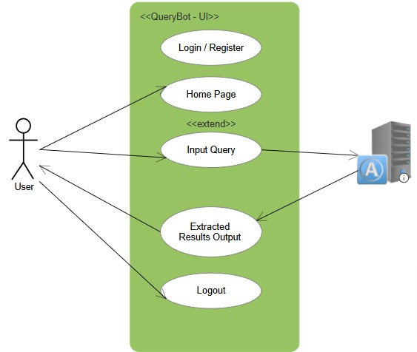
Architecture

Slide 12
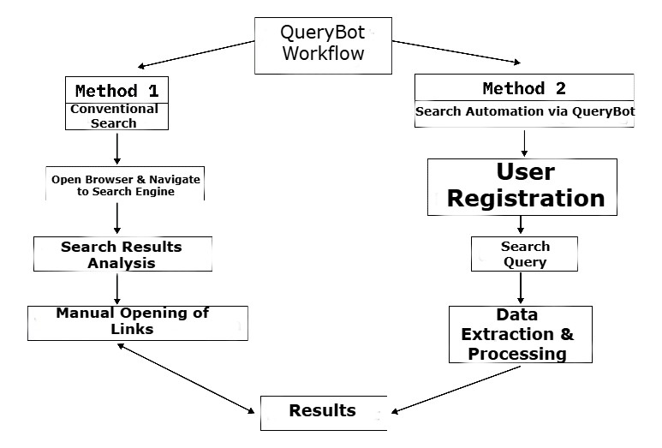
Working Model

Slide 13
Hardware/software components
Software Requirements
RPA Tool: UiPath or Blue Prism for automation tasks.
Web Browser: Google Chrome or Mozilla Firefox for executing search operations.
Spreadsheet Software: Microsoft Excel or Google Sheets for data storage.
Programming Environment: Python (optional, for any additional scripting needs).
These requirements ensure that the automation process runs smoothly without hardware or software bottlenecks.

Slide 14
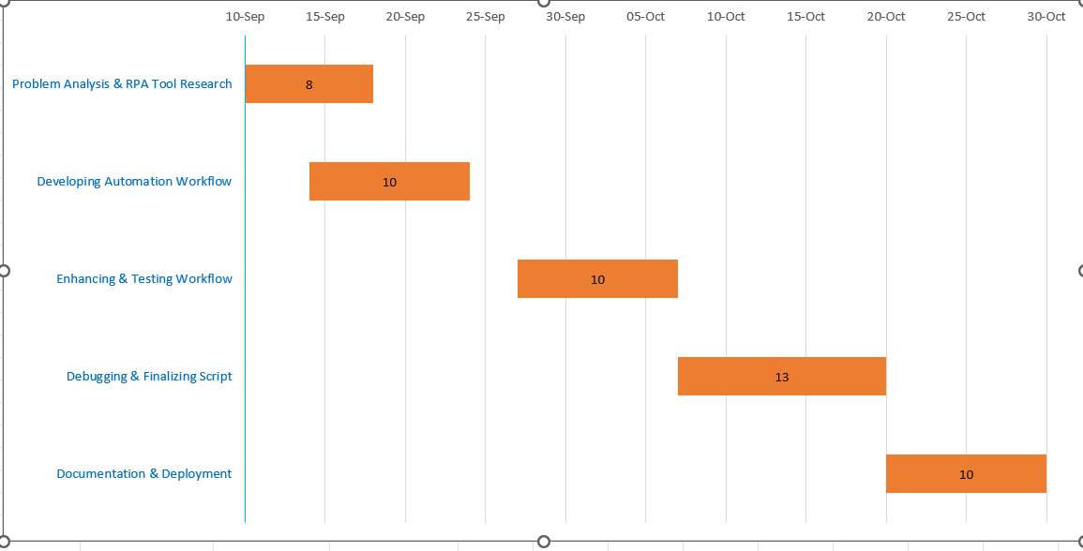
Timeline of Project

Slide 15
Expected Outcomes
The main outcome of this project is the successful automation of Google search result processing. Using Robotic Process Automation (RPA), the project extracts relevant information from search results and structures it into an easily consumable format (such as an Excel sheet or table). This automation reduces the time and manual effort needed to sift through web pages, making the entire process more efficient and user-friendly. The tool developed can be adapted for various search queries, making it useful in research, marketing, and business data gathering.
Reduction in Manual Effort: Eliminates the need for users to manually browse through search links to extract information.
Time Efficiency: Results are presented in a structured format (table or Excel) instantly, saving significant time.
Scalability: Can be adapted for different search queries and scaled to handle a large volume of search results.
Accuracy: RPA reduces the possibility of human error in data extraction.

Slide 16
Conclusion
This project demonstrates how RPA can be leveraged to automate and optimize the process of extracting and organizing Google search results. By mimicking manual browsing and data extraction processes, the RPA tool offers a reliable and scalable solution that minimizes user effort and maximizes time efficiency. The project is especially relevant for businesses, researchers, and digital marketers who need to extract structured data from search engines. This automated system can significantly reduce operational costs, increase productivity, and improve data accuracy, offering a sustainable alternative to manual search result processing.
The successful deployment of this tool showcases the potential of RPA in streamlining data-related tasks across multiple domains, including business intelligence, research, and online marketing. Future work can involve enhancing the tool’s capabilities by integrating machine learning to refine the extracted data based on user preferences.

Slide 17
Github Link
The Github link provided should have public access permission.
Github Link:
https://github.com/Anjiuluva7/Google-Search-Engine-Using-RPA-

Slide 18
References
Mehta, R., & Chaher, R. (2022). Implementation of Robotic Process Automation (RPA) in Digital Marketing. 2022 3rd International Conference for Emerging Technology (INCET). IEEE.
This paper discusses the role of RPA in automating digital marketing processes, which aligns with your project’s focus on automating data extraction tasks.
Patrício, L., Costa, C. R. de S., Varela, L., & Cruz-Cunha, M. M. (2024). Literature review on the sustainable implementation of Robotic Process Automation (RPA) in medical and healthcare administrative services. Procedia Computer Science, 239, 166.
The paper provides insights into the sustainable application of RPA, relevant for understanding the broader implications of automation in administrative processes.
Geyer-Klingeberg, J., Nakladal, J., Baldauf, F., & Veit, F. (2018). Process mining and Robotic Process Automation: A perfect match. cognitiveX Blog.
This article explains how RPA can work alongside process mining to enhance efficiency, directly applicable to your Google search automation project.

Slide 19
Agostinelli, S., Marrella, A., & Mecella, M. (2019). Research challenges for Robotic Process Automation. ICPM 2019 - IEEE International Conference on Process Mining. IEEE.
This paper highlights the current challenges in RPA implementation, providing useful context for refining your project's methodology.
"A Comparative Analysis of Automation Anywhere, UiPath, and Blue Prism" https://ieeexplore.ieee.org/document/10182777
APA Citation: Author(s). (Year). A comparative analysis of Automation Anywhere, UiPath, and Blue Prism. IEEE
Xplore. https://ieeexplore.ieee.org/document/10182777
"Effectiveness of Robotic Process Automation for Data Mining Using UiPath" https://ieeexplore.ieee.org/document/9396024
APA Citation: Author(s). (Year). Effectiveness of robotic process automation for data mining using UiPath.
IEEE Xplore. https://ieeexplore.ieee.org/document/9396024

Slide 20
https://www.researchgate.net/publication/373845876_A_Systematic_Review_of_Robotic_Process_Automation_in_Business_Operations_Contemporary_Trends_and_Insights
https://www.researchgate.net/publication/382613045_Literature_review_on_the_sustainable_implementation_of_Robotic_Process_Automation_RPA_in_medical_and_healthcare_administrative_services
https://www.researchgate.net/publication/326466901_Process_Mining_and_Robotic_Process_Automation_A_Perfect_Matchhttps://www.researchgate.net/publication/326466901_Process_Mining_and_Robotic_Process_Automation_A_Perfect_Match
https://www.researchgate.net/publication/338352191_Research_Challenges_for_Intelligent_Robotic_Process_Automation
https://ieeexplore.ieee.org/document/10182777
https://ieeexplore.ieee.org/document/9396024

Slide 21

Project work mapping with SDG

Slide 22
Thank You

